Slide 1
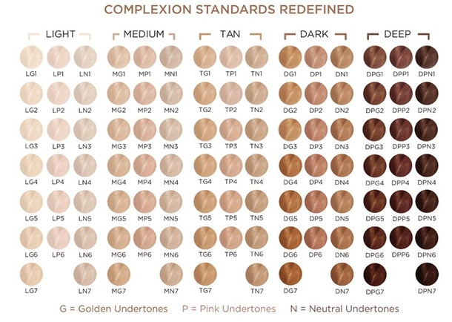
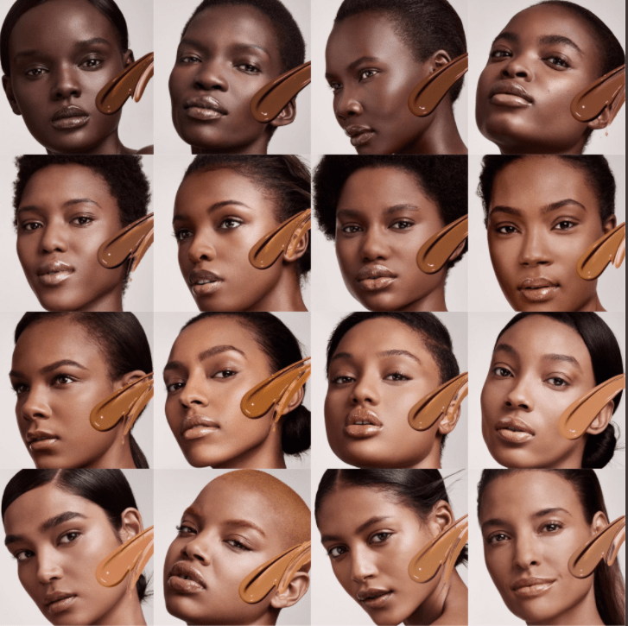
Hey, What’s Your Shade?
Keeshan Williams, PhD.

Slide 2
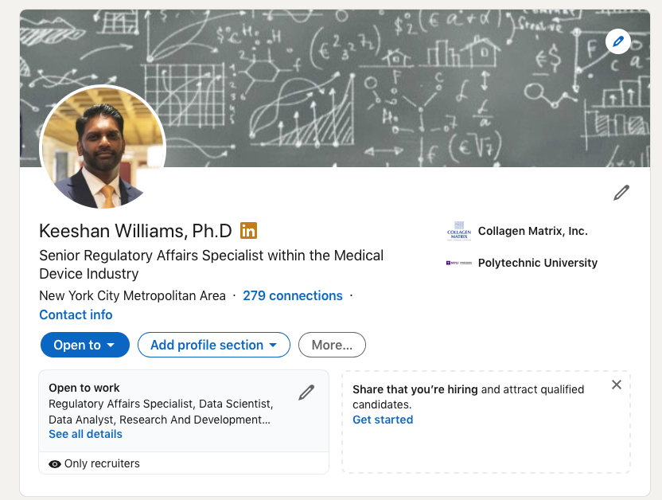


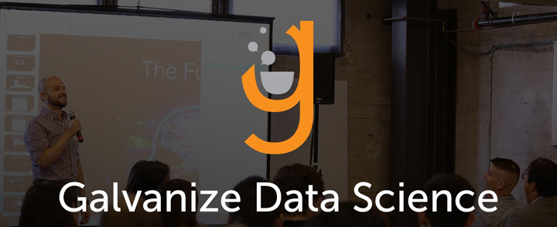


About me…
2012
PhD., Chem . Eng.
2018
Scientist
2019
Sr. Engineer Officer (LT)
2020
Regulatory Affairs Specialist
2021
Data Scientist

Slide 3







Hey, What’s your Shade?
Goal: Recommend a makeup shade color that is the ideal match to your skin tone
Use computer vision model to identify faces in an image
Determine regions of the face that yield an accurate determination of skin color
Compare normalized color based on pixel values of regions with database of foundation colors
Make recommendation of closest match

Slide 4
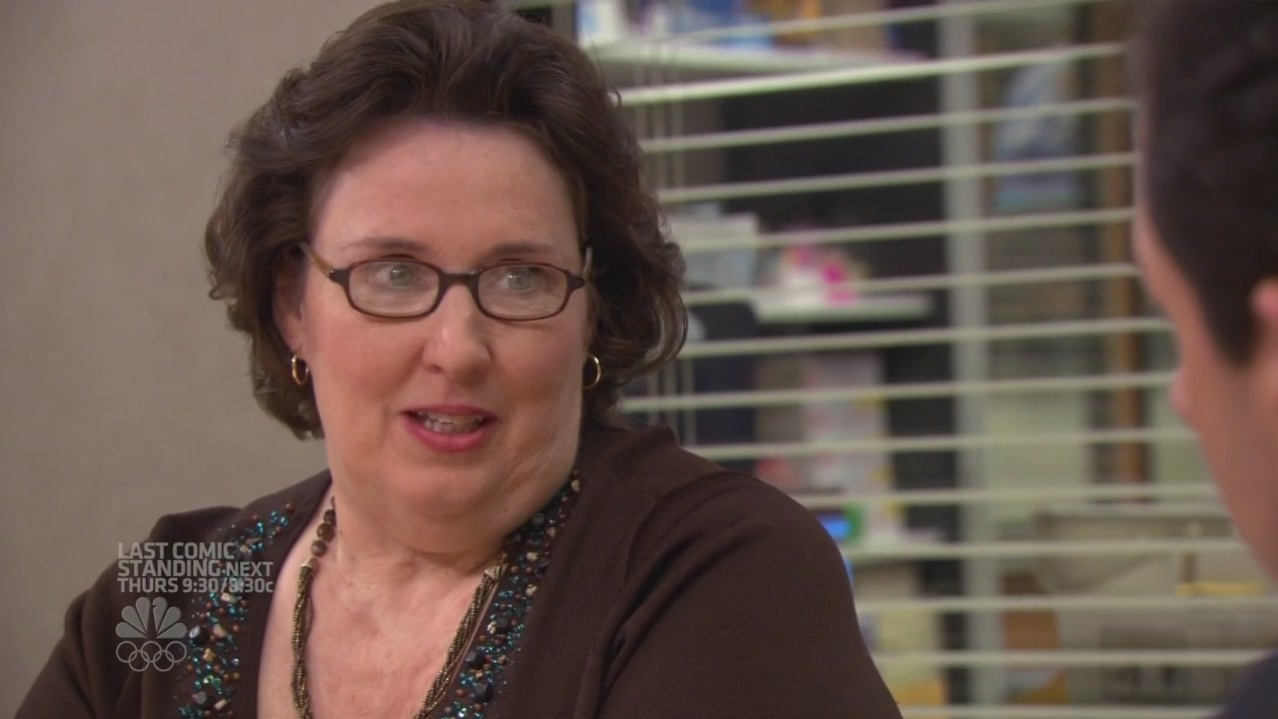
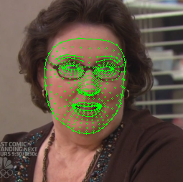
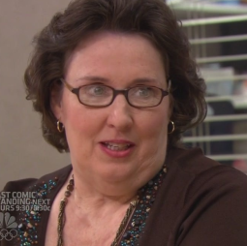
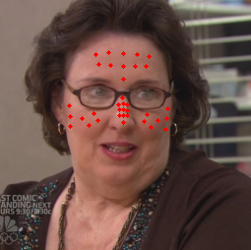
Hey, What’s your Shade? - Algorithm

Slide 5
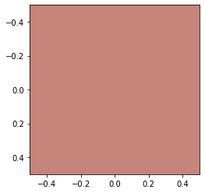
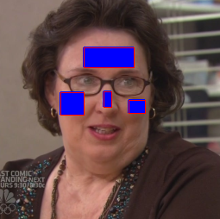

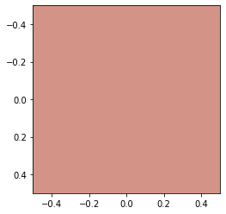
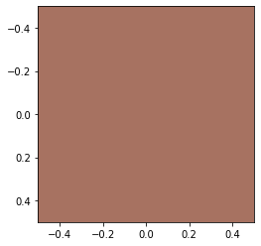
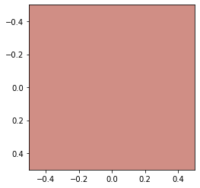
Hey, What’s your Shade? - Algorithm

Slide 6
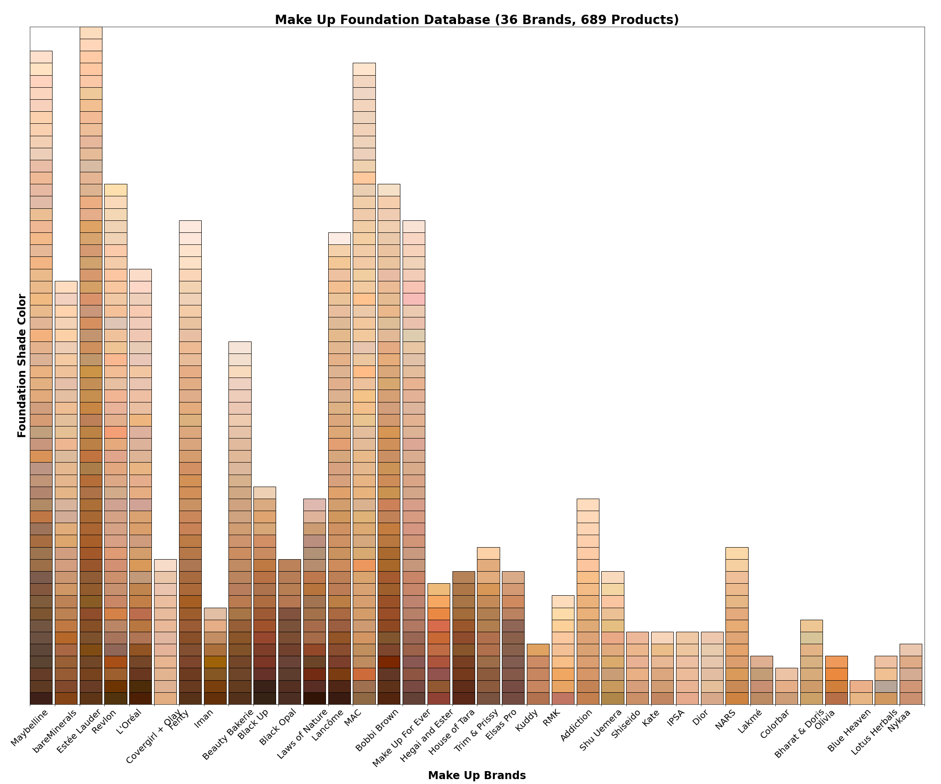

Slide 7
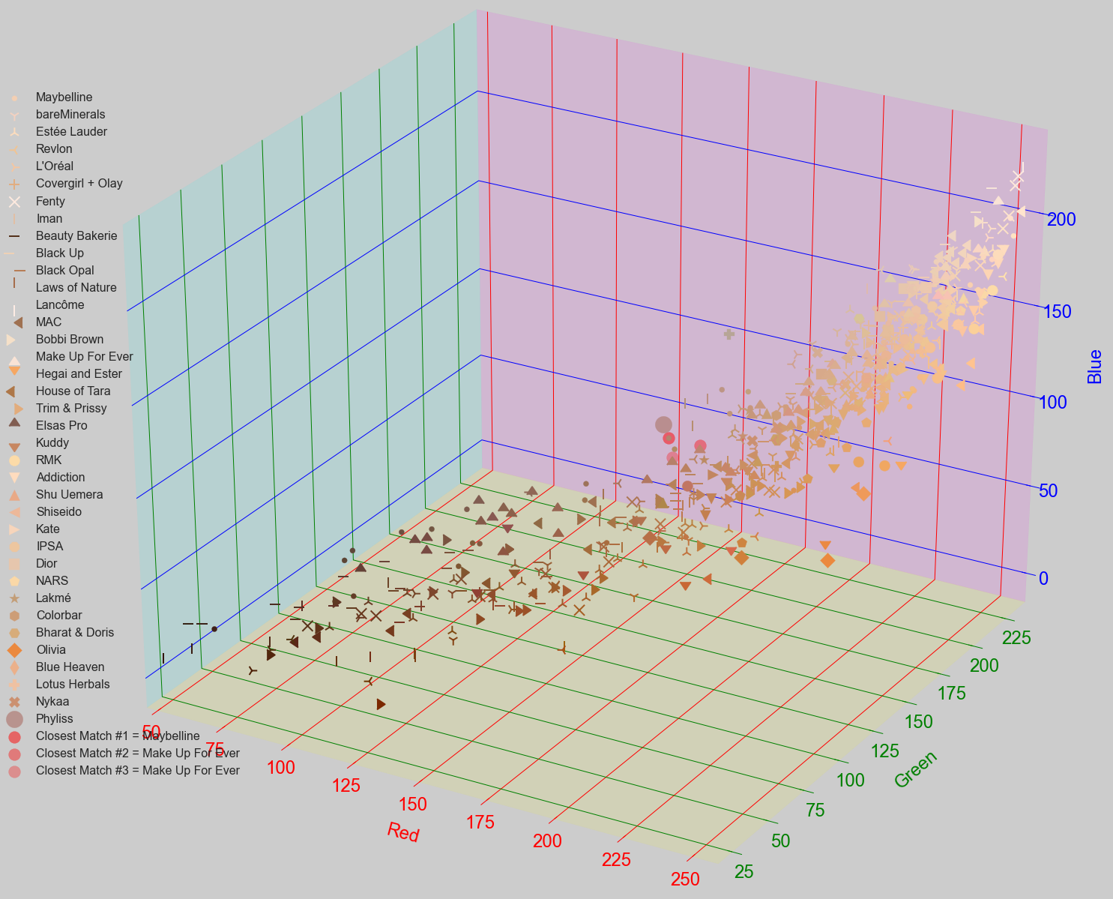

Slide 8

Hey, What’s your Shade?
LIVE DEMO TIME!!!!!

Slide 9
